Slide 1
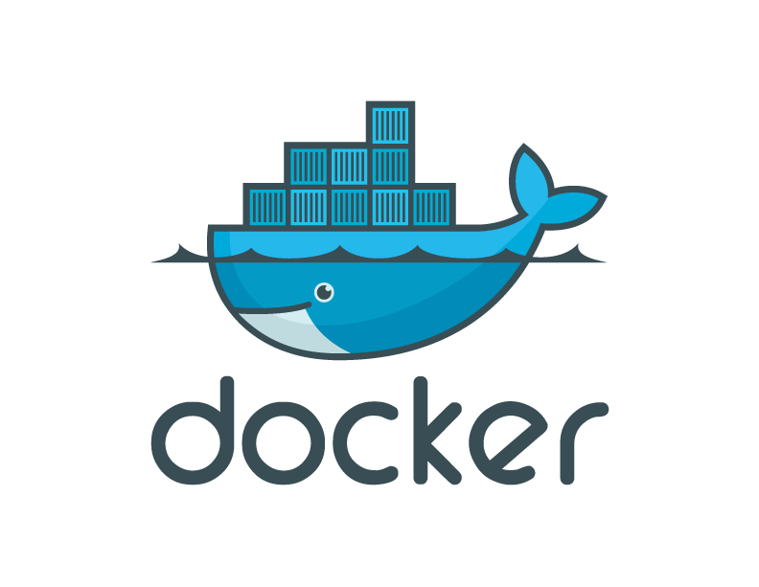
Introduction to Docker November, 2013

Slide 2
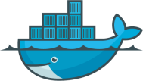
Contents
Introduction to Docker, Containers, and the Matrix from Hell
Why people care: Separation of Concerns
Technical Discussion
Ecosystem
Use Cases
Docker Futures
Advanced topics: Networking, Data
OpenStack
Learn More

Slide 3
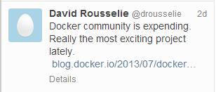

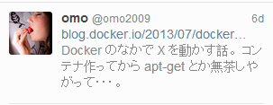
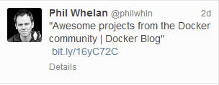

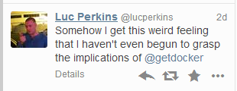
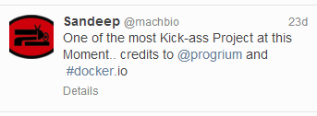
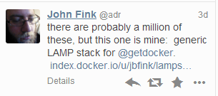
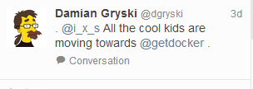
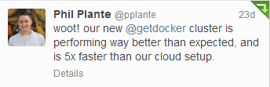
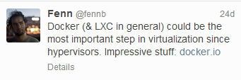
In the 8 months since we launched
>200,000 pulls
>7,500 github stars
>200 significant contributors
>200 projects built on top of docker
UIs, mini-PaaS, Remote Desktop….
1000’s of Dockerized applications
Memcached, Redis, Node.js…and Hadoop
Integration in Jenkins, Travis, Chef, Puppet, Vagrant and OpenStack
Meetups arranged around the world…with organizations like Ebay, Cloudflare, Yandex, and Rackspace presenting on their use of Docker

Slide 4
Why all the excitement?

Slide 5

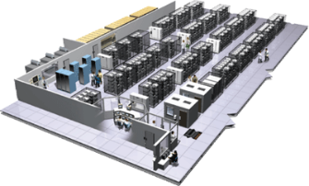

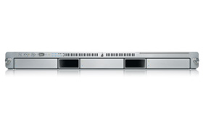
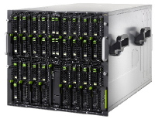

The Challenge
User DB
Static website
postgresql + pgv8 + v8
Queue
Analytics DB
nginx 1.5 + modsecurity + openssl + bootstrap 2
Do services and apps interact appropriately?
Redis + redis-sentinel
hadoop + hive + thrift + OpenJDK
Multiplicity of Stacks
Background workers
Web frontend
Python 3.0 + celery + pyredis + libcurl + ffmpeg + libopencv + nodejs + phantomjs
Ruby + Rails + sass + Unicorn
API endpoint
Python 2.7 + Flask + pyredis + celery + psycopg + postgresql-client
Production Cluster
Development VM
Public Cloud
Multiplicity of hardware environments
QA server
Can I migrate smoothly and quickly?
Disaster recovery
Customer Data Center
Contributor’s laptop
Production Servers

Slide 6
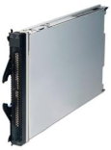
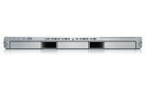
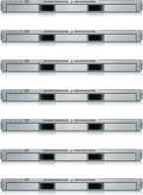

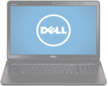
The Matrix From Hell
? | ? | ? | ? | ? | ? | ?
? | ? | ? | ? | ? | ? | ?
? | ? | ? | ? | ? | ? | ?
? | ? | ? | ? | ? | ? | ?
? | ? | ? | ? | ? | ? | ?
? | ? | ? | ? | ? | ? | ?
Static website
Web frontend
Background workers
User DB
Analytics DB
Queue
 | Development VM | QA Server | Single Prod Server | Onsite Cluster | Public Cloud | Contributor’s laptop | Customer Servers

Slide 7

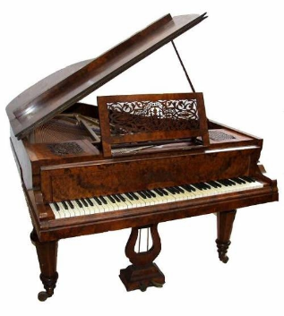

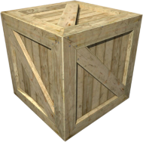
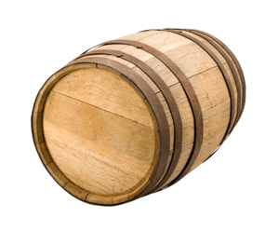
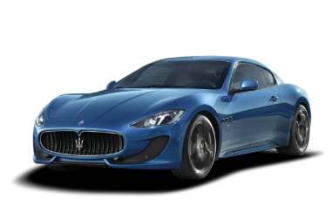
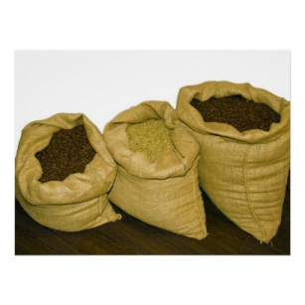



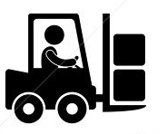
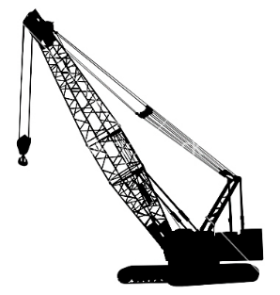
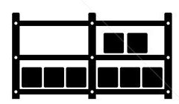

Cargo Transport Pre-1960
Do I worry about how goods interact (e.g. coffee beans next to spices)
Multiplicity of Goods
Multipilicity of methods for transporting/storing
Can I transport quickly and smoothly
(e.g. from boat to train to truck)

Slide 8


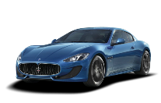


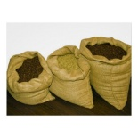


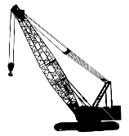



Also a matrix from hell
 | ? | ? | ? | ? | ? | ? | ?
 | ? | ? | ? | ? | ? | ? | ?
 | ? | ? | ? | ? | ? | ? | ?
 | ? | ? | ? | ? | ? | ? | ?
 | ? | ? | ? | ? | ? | ? | ?
 | ? | ? | ? | ? | ? | ? | ?

Slide 9



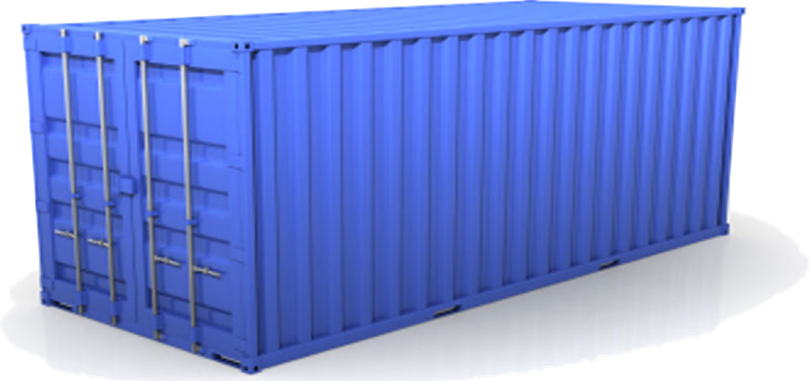
Solution: Intermodal Shipping Container
Do I worry about how goods interact (e.g. coffee beans next to spices)
Multiplicity of Goods
A standard container that is loaded with virtually any goods, and stays sealed until it reaches final delivery.
…in between, can be loaded and unloaded, stacked, transported efficiently over long distances, and transferred from one mode of transport to another
Can I transport quickly and smoothly
(e.g. from boat to train to truck)
Multiplicity of methods for transporting/storing

Slide 10
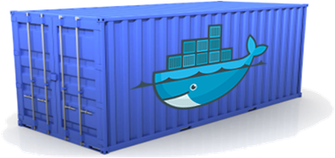
Docker is a shipping container system for code
Static website
User DB
Web frontend
Queue
Analytics DB
Do services and apps interact appropriately?
Multiplicity of Stacks
An engine that enables any payload to be encapsulated as a lightweight, portable, self-sufficient container…
…that can be manipulated using standard operations and run consistently on virtually any hardware platform
Multiplicity of hardware environments
Can I migrate smoothly and quickly
Development VM
QA server
Customer Data Center
Public Cloud
Production Cluster
Contributor’s laptop

Slide 11

Docker eliminates the matrix from Hell
Static website
Web frontend
Background workers
User DB
Analytics DB
Queue
 | Development VM | QA Server | Single Prod Server | Onsite Cluster | Public Cloud | Contributor’s laptop | Customer Servers

Slide 12
Why Developers Care
Build once…(finally) run anywhere*
A clean, safe, hygienic and portable runtime environment for your app.
No worries about missing dependencies, packages and other pain points during subsequent deployments.
Run each app in its own isolated container, so you can run various versions of libraries and other dependencies for each app without worrying
Automate testing, integration, packaging…anything you can script
Reduce/eliminate concerns about compatibility on different platforms, either your own or your customers.
Cheap, zero-penalty containers to deploy services? A VM without the overhead of a VM? Instant replay and reset of image snapshots? That’s the power of Docker
* With the 0.7 release, we support any x86 server running a modern Linux kernel (3.2+ generally. 2.6.32+ for RHEL 6.5+, Fedora, & related)

Slide 13
Why Devops Cares?
Configure once…run anything
Make the entire lifecycle more efficient, consistent, and repeatable
Increase the quality of code produced by developers.
Eliminate inconsistencies between development, test, production, and customer environments
Support segregation of duties
Significantly improves the speed and reliability of continuous deployment and continuous integration systems
Because the containers are so lightweight, address significant performance, costs, deployment, and portability issues normally associated with VMs

Slide 14
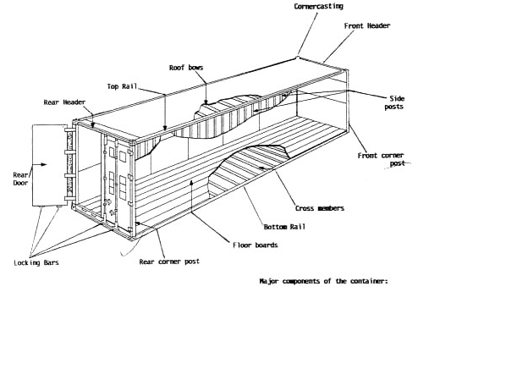
Why it works—separation of concerns
Dan the Developer
Worries about what’s “inside” the container
His code
His Libraries
His Package Manager
His Apps
His Data
All Linux servers look the same
Oscar the Ops Guy
Worries about what’s “outside” the container
Logging
Remote access
Monitoring
Network config
All containers start, stop, copy, attach, migrate, etc. the same way

Slide 15
More technical explanation
WHY
WHAT
Run everywhere
Regardless of kernel version (2.6.32+)
Regardless of host distro
Physical or virtual, cloud or not
Container and host architecture must match*
Run anything
If it can run on the host, it can run in the container
i.e. if it can run on a Linux kernel, it can run
High Level—It’s a lightweight VM
Own process space
Own network interface
Can run stuff as root
Can have its own /sbin/init (different from host)
<<machine container>>
Low Level—It’s chroot on steroids
Can also not have its own /sbin/init
Container=isolated processes
Share kernel with host
No device emulation (neither HVM nor PV) from host)
<<application container>>

Slide 16
Containers vs. VMs
App
A
App
A’
App
B
Containers are isolated,
but share OS and, where
appropriate, bins/libraries
Bins/
Libs
Bins/
Libs
Bins/
Libs
VM
Guest
OS
Guest
OS
Guest
OS
…result is significantly faster deployment, much less overhead, easier migration, faster restart
Guest
OS
Guest
OS
App A
App A’
App B
App B’
App B’
App B’
Container
Docker
Hypervisor (Type 2)
Bins/Libs
Bins/Libs
Host OS
Host OS
Server
Server

Slide 17
Why are Docker containers lightweight?
VMs
Containers
App
A
App
A
App
A’
App
A
App
A
App Δ
Bins/
Libs
Bins/
Libs
Bins/
Libs
Bins/
Libs
Bins/
Guest
OS
Guest
OS
Guest
OS
Guest
OS
Original App
(No OS to take
up space, resources,
or require restart)
Copy of
App
No OS. Can
Share bins/libs
Modified App
Copy on write capabilities allow
us to only save the diffs
Between container A and container
A’
VMs
Every app, every copy of an
app, and every slight modification
of the app requires a new virtual server

Slide 18
What are the basics of the Docker system?
Container A
Docker
Container
Image Registry
Push
Search
Pull
Source Code Repository
Run
Build
Dockerfile
For
A
Container A
Container B
Container C
Docker
Docker Engine
Host 1 OS (Linux)
Host 2 OS (Linux)

Slide 19
Changes and Updates
Docker
Container
Image Registry
App
A
Push
App Δ
Bins/
Libs
Bins/
Base
Container
Image
Container Mod A’
Container Mod A’’
App Δ
Update
App
A
Bins/
App
A’’
Bins/
Libs
Bins/
Libs
Bins/
Docker Engine
Docker Engine
Host is now running A’’
Host running A wants to upgrade to A’’. Requests update. Gets only diffs

Slide 20

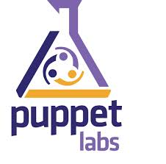
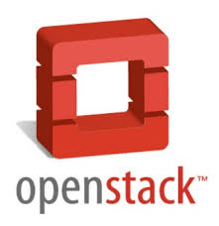






Ecosystem Support
Operating systems
Virtually any distribution with a 2.6.32+ kernel
Red Hat/Docker collaboration to make work across RHEL 6.4+, Fedora, and other members of the family (2.6.32 +)
CoreOS—Small core OS purpose built with Docker
OpenStack
Docker integration into NOVA (& compatibility with Glance, Horizon, etc.) accepted for Havana release
Private PaaS
OpenShift
Solum (Rackspace, OpenStack)
Other TBA
Public PaaS
Deis, Voxoz, Cocaine (Yandex), Baidu PaaS
Public IaaS
Native support in Rackspace, Digital Ocean,+++
AMI (or equivalent) available for AWS & other
DevOps Tools
Integrations with Chef, Puppet, Jenkins, Travis, Salt, Ansible +++
Orchestration tools
Mesos, Heat, ++
Shipyard & others purpose built for Docker
Applications
1000’s of Dockerized applications available at index.docker.io

Slide 21
Use Cases
Ted Dziuba on the Use of Docker for Continuous Integration at Ebay Now
https://speakerdeck.com/teddziuba/docker-at-ebay
http://www.youtube.com/watch?feature=player_embedded&v=0Hi0W4gX--4
Sasha Klizhentas on use of Docker at Mailgun/Rackspace
http://www.youtube.com/watch?feature=player_embedded&v=CMC3xdAo9RI
Sebastien Pahl on use of Docker at CloudFlare
http://www.youtube.com/watch?feature=player_embedded&v=-Lj3jt_-3r0
Cambridge HealthCare
http://blog.howareyou.com/post/62157486858/continuous-delivery-with-docker-and-jenkins-part-i
Red Hat Openshift and Docker
https://www.openshift.com/blogs/technical-thoughts-on-openshift-and-docker

Slide 22
Use Cases—From Our Community
Use Case | Examples | Link
Clusters | Building a MongoDB cluster using docker | http://bit.ly/1acbjZf
 | Production Quality MongoDB Setup with Docker | http://bit.ly/15CaiHb
 | Wildfly cluster using Docker on Fedora | http://bit.ly/1bClX0O
Build your own PaaS | OpenSource PaaS built on Docker, Chef, and Heroku Buildpacks | http://deis.io
Web Based Environment for Instruction | JiffyLab – web based environment for the instruction, or lightweight use of, Python and UNIX shell | http://bit.ly/12oaj2K
Easy Application Deployment | Deploy Java Apps With Docker = Awesome | http://bit.ly/11BCvvu
 | How to put your development environment on docker | http://bit.ly/1b4XtJ3
 | Running Drupal on Docker | http://bit.ly/15MJS6B
 | Installing Redis on Docker | http://bit.ly/16EWOKh
Create Secure Sandboxes | Docker makes creating secure sandboxes easier than ever | http://bit.ly/13mZGJH
Create your own SaaS | Memcached as a Service | http://bit.ly/11nL8vh
Automated Application Deployment | Multi-cloud Deployment with Docker | http://bit.ly/1bF3CN6
Continuous Integration and Deployment | Next Generation Continuous Integration & Deployment with dotCloud’s Docker and Strider | http://bit.ly/ZwTfoy
 | Testing Salt States Rapidly With Docker | http://bit.ly/1eFBtcm
Lightweight Desktop Virtualization | Docker Desktop: Your Desktop Over SSH Running Inside Of A Docker Container | http://bit.ly/14RYL6x

Slide 23
Docker Futures*
Docker 0.7 (current release)
Fedora compatibility
Reduce kernel dependencies
Device mapper
Container linking
Docker 0.8 (Dec)
Shrink and stabilize Core
Provide stable, pluggable API
RHEL compatibility
Nested containers
Beam: Introspection API based on Redis
expand snapshot management features for data volumes
We will consider this “production ready”
Docker 0.9 (Jan)
Docker 1.0 (Feb)
We will offer support for this product
Docker 0.1-0.6
Service
Discover
SELinux
LXC
Docker 0.8+
AUFS
LIBVIRT
Device
Mapper
JAILS
LXC
* We shoot for time based releases (1x/5wks), features are targeted, but not guaranteed for particular releases

Slide 24
Advanced topics
Data
Today: Externally mounted volumes
Share volumes between containers
Share volume between a containers and underlying hosts
high-performance storage backend for your production database
making live development changes available to a container, etc.
Optional: specify memory limit for containers, CPU priority
Device mapper/ LVM snapshots in 0.7
Futures:
I/O limits
Container resource monitoring (CPU & memory usage)
Orchestration (linking & synchronization between containers)
Cluster orchestration (multi-host environment)
Networking
Supported today:
UDP/TCP port allocation to containers
specify which public port to redirect. If you don’t specify a public port, Docker will revert to allocating a random public port.
Docker uses IPtables/netfilter
IP allocation to containers
Docker uses virtual interfaces, network bridge,
Futures:
See Pipework (Upstream) : Software-Defined Networking for Linux Containers (https://github.com/jpetazzo/pipework)
Certain pipework concepts will move from upstream to part of core Docker
Additional capabilities come with libvirt support in 0.8-0.9 timeframe

Slide 25
OpenStack / Docker
New hypervisor to enable Nova to deploy Linux containers

Slide 26
Why Docker + OpenStack
Alternative to VMs within OpenStack-today
Easier deployment of OpenStack itself-near future
Cross cloud application deployment
At OpenStack Summit we will show:
Building and testing an application from source
Running on a laptop
Running it, without modification or noticeable downtime, on a public cloud
Running it, without modification or noticeable downtime, on an openstack cluster
Doing all of the above using Nova, Glance and Horizon
Containers orchestration with OpenStack Heat (Demo at summit)

Slide 27
Why a new hypervisor?
Nova a computing controller for OpenStack
Nova support for containers is minimal (via LibVirt)
Enables control of Docker through OpenStack projects (ex: deploy containers via Horizon Web UI)

Slide 28
Want to learn more?
www.docker.io:
Documentation
Getting started: interactive tutorial, installation instructions, getting started guide,
About: Introductory whitepaper: http://www.docker.io/the-whole-story/
Github: dotcloud/docker
IRC: freenode/#docker
Google groups: groups.google.com/forum/#!forum/docker-user
Twitter: follow @docker
Meetups: Scheduled for Boston, San Francisco, Austin, London, Paris, Boulder…and Nairobi. https://www.docker.io/meetups/

Slide 29
www.docker.io

